Slide 1
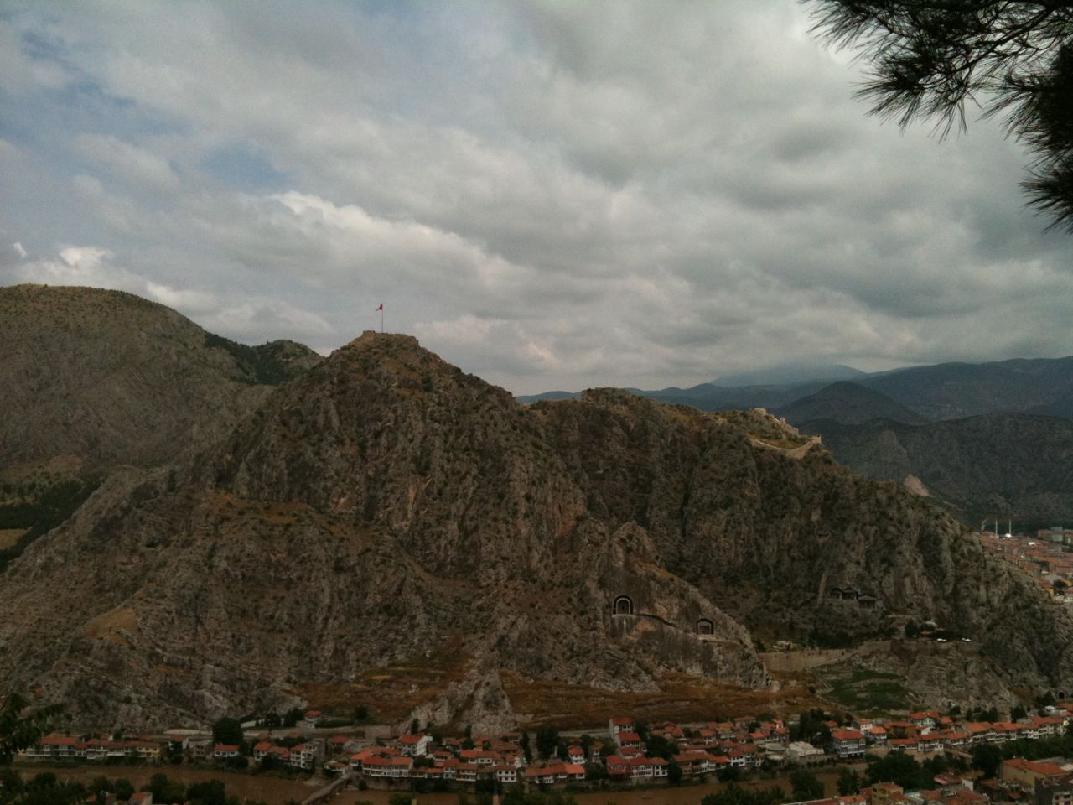
1 Peter 2.11-25
Doing what is right
even when it costs us.
Tombs in the mountain overlooking Amasya, in Pontus [Turkey].
This picture is from the Zulfikar family collection.
Dr. F. Canguzel Zulfikar granted permission for its use.

Slide 2
2.11-12: Dear friends, I urge you as foreigners and exiles to keep away from fleshly desires that do battle against the soul, and maintain good conduct among the non-Christians, so that though they now malign you as wrongdoers, they may see your good deeds and glorify God when he appears.

Slide 3
2.11-12: Dear friends, I urge you as foreigners and exiles to keep away from fleshly desires that do battle against the soul, and maintain good conduct among the non-Christians, so that though they now malign you as wrongdoers, they may see your good deeds and glorify God when he appears.

Slide 4
2.11-12: Dear friends, I urge you as foreigners and exiles to keep away from fleshly desires that do battle against the soul, and maintain good conduct among the non-Christians, so that though they now malign you as wrongdoers, they may see your good deeds and glorify God when he appears.

Slide 5
2.13-17: Be subject to every human institution for the Lord's sake, whether to a king as supreme or to governors as those he commissions to punish wrongdoers and praise those who do good. For God wants you to silence the ignorance of foolish people by doing good. Live as free people, not using your freedom as a pretext for evil, but as God's slaves. Honor all people, love the family of believers, fear God, honor the king.

Slide 6
2.13-17: Be subject to every human institution for the Lord's sake, whether to a king as supreme or to governors as those he commissions to punish wrongdoers and praise those who do good. For God wants you to silence the ignorance of foolish people by doing good. Live as free people, not using your freedom as a pretext for evil, but as God's slaves. Honor all people, love the family of believers, fear God, honor the king.

Slide 7
2.13-17: Be subject to every human institution for the Lord's sake, whether to a king as supreme or to governors as those he commissions to punish wrongdoers and praise those who do good. For God wants you to silence the ignorance of foolish people by doing good. Live as free people, not using your freedom as a pretext for evil, but as God's slaves. Honor all people, love the family of believers, fear God, honor the king.

Slide 8
2.18-20: Slaves, be subject to your masters with all reverence, not only to those who are good and gentle, but also to those who are perverse. For this finds God's favor, if because of conscience toward God someone endures hardships in suffering unjustly. For what credit is it if you sin and are mistreated and endure it? But if you do good and suffer and so endure, this finds favor with God.

Slide 9
2.18-20: Slaves, be subject to your masters with all reverence, not only to those who are good and gentle, but also to those who are perverse. For this finds God's favor, if because of conscience toward God someone endures hardships in suffering unjustly. For what credit is it if you sin and are mistreated and endure it? But if you do good and suffer and so endure, this finds favor with God.

Slide 10
2.21-23: For to this you were called, since Christ also suffered for you, leaving an example for you to follow in his steps. He committed no sin nor was deceit found in his mouth. When he was maligned, he did not answer back; when he suffered, he threatened no retaliation, but committed himself to God who judges justly.

Slide 11
2.21-23: For to this you were called, since Christ also suffered for you, leaving an example for you to follow in his steps. He committed no sin nor was deceit found in his mouth. When he was maligned, he did not answer back; when he suffered, he threatened no retaliation, but committed himself to God who judges justly.

Slide 12
2.24-25: He himself bore our sins in his body on the tree, that we may cease from sinning and live for righteousness. By his wounds you were healed. For you were going astray like sheep but now you have turned back to the shepherd and guardian of your souls.

Slide 13
Christ’s example:
† Undergo unjust and sacrificial suffering for the sake of the gospel mission, righteousness, and benefit of others.
† Remain sinless, continuing to do what is right even if it leads to more suffering, loving even enemies.
† Trust your deliverance to God and trust God with the judgment of others.

Slide 14
1 Peter 2.11-25
Doing what is right
even when it costs us.
Tombs in the mountain overlooking Amasya, in Pontus [Turkey].
This picture is from the Zulfikar family collection.
Dr. F. Canguzel Zulfikar granted permission for its use.

